Slide 1
Digitization and interactive multimedia
Tse Ka Kee 115068
Tse Lai Wai 115073
Kwan Chung Ping 115081
Chan Jeco 115088
Fong Kin Ming 115141

Slide 2
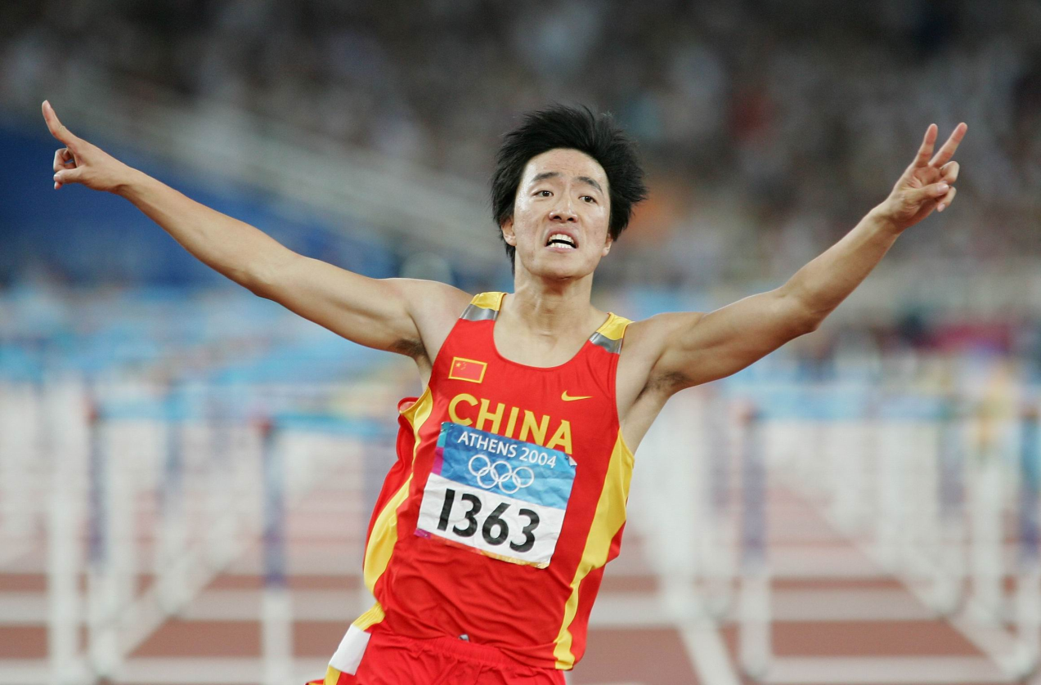
劉翔 Liu xiang

Slide 3
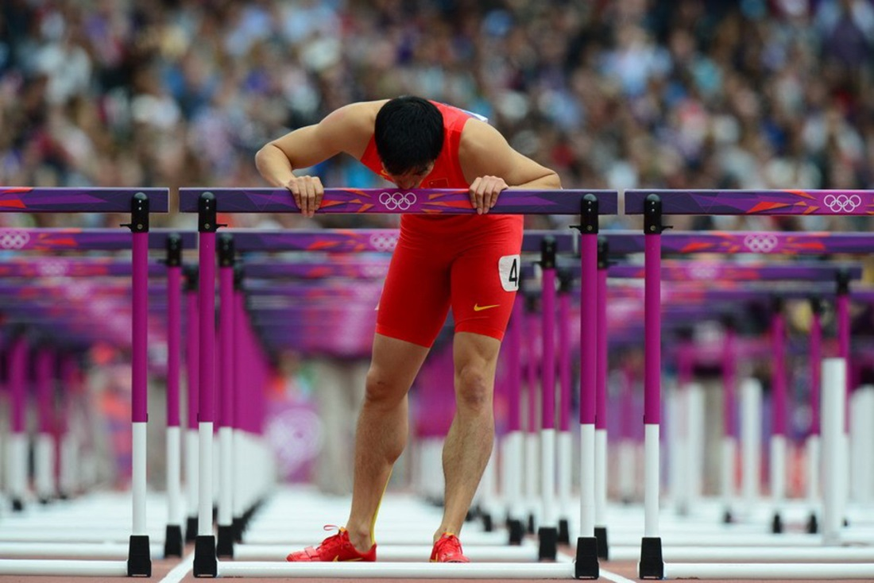
Why liu xiang?
Famous in China
Announced retirement on 7th April
One of the greatest 110m hurdle athletes

Slide 4
Structure
Timeline-based
Straight linear movement, moving upward
https://drive.google.com/file/d/0B8BQJDHbq9jaNDdITjRUcFFVZnc/view?usp=sharing

Slide 5
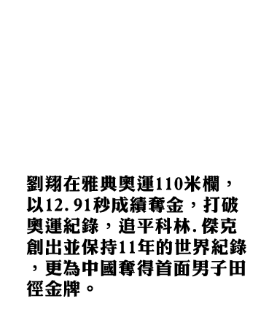
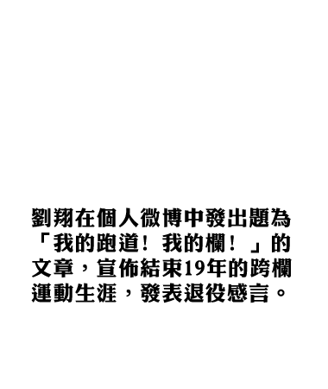


structure
Informative
Biography of Liu Xiang’s career
Font- 儷黑金體

Slide 6
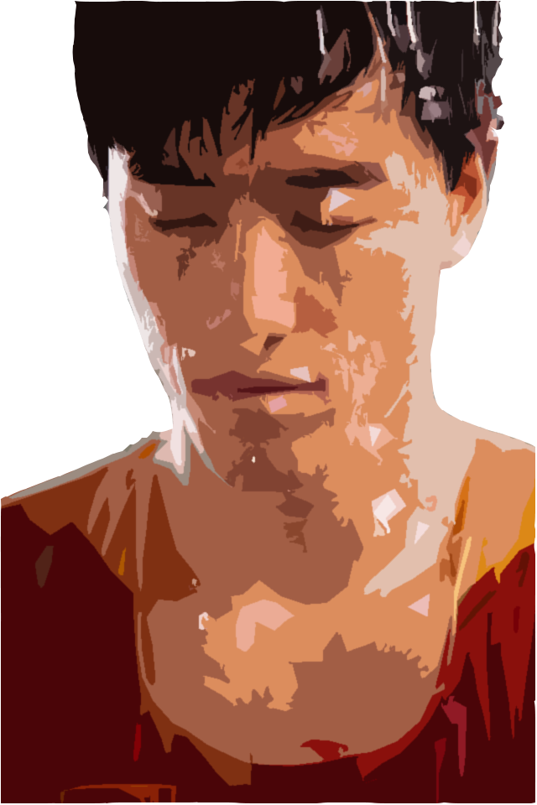
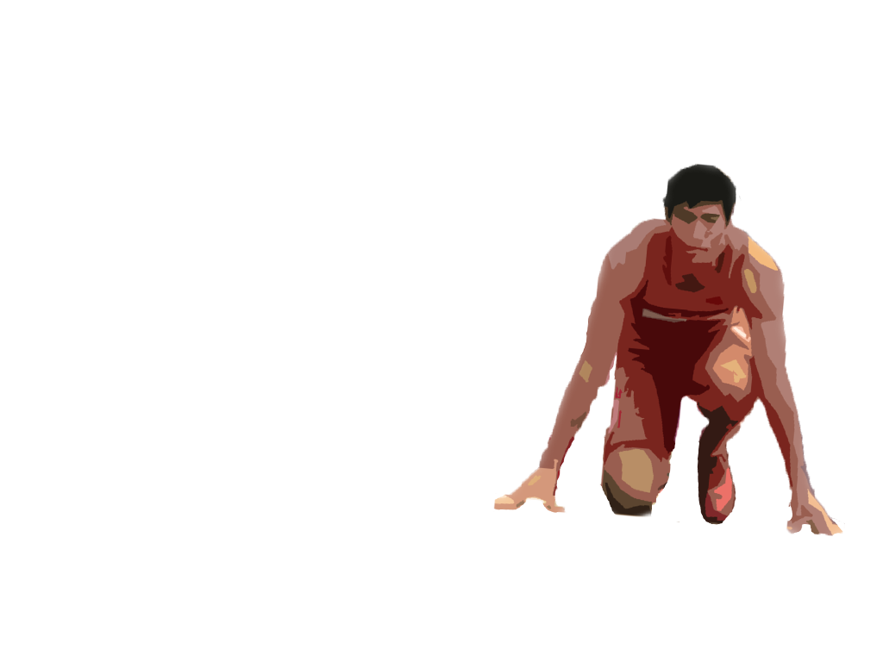
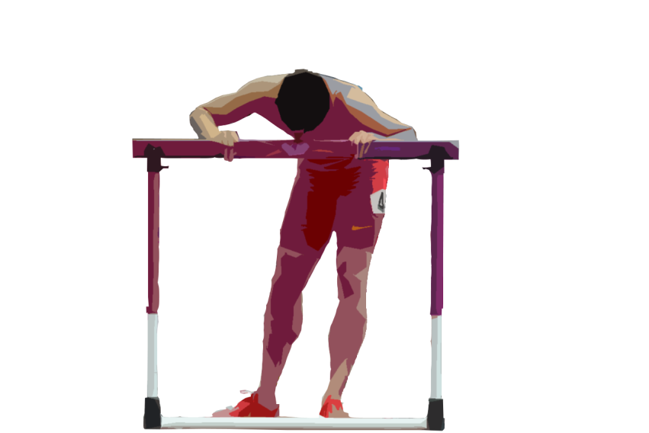
visual
Theme colour
Red
Graphics
Same pattern- cutout effect

Slide 7
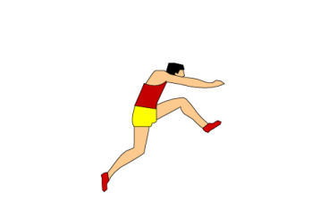
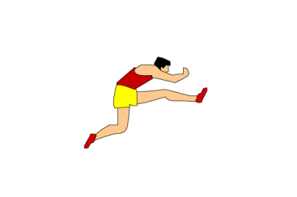
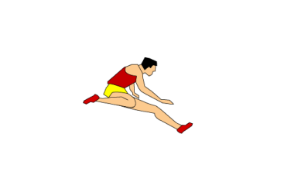
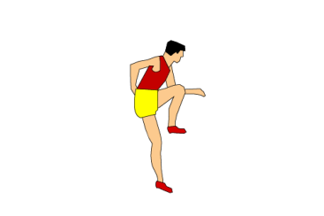
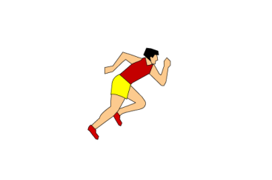
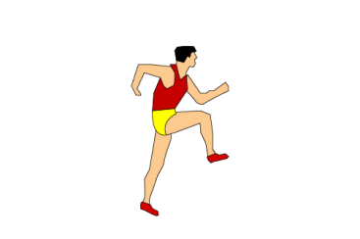
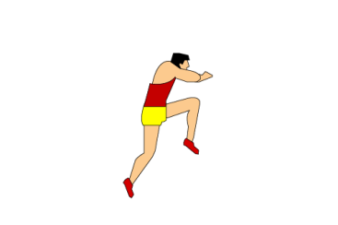
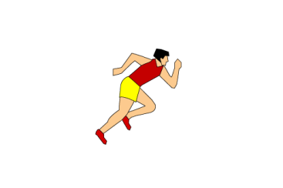
visual
Graphics
Stepwise progression

Slide 8
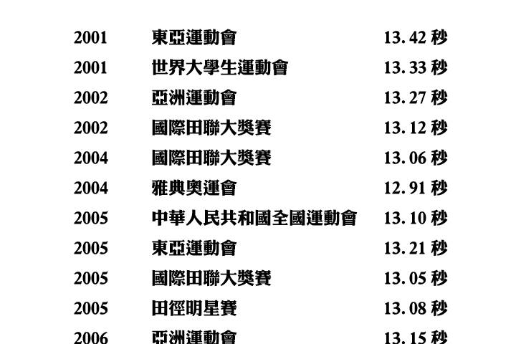
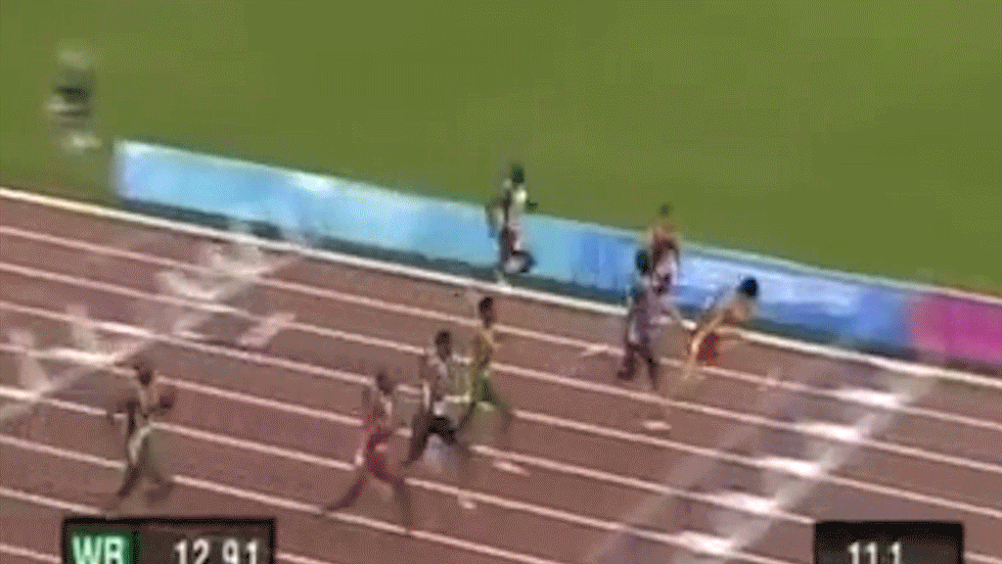
visual
GIF

Slide 9
difficulties
Web design- Alignment of different objects
Graphic design
Background- How to make it look like a track and field and fits our graphic pattern

